Slide 1

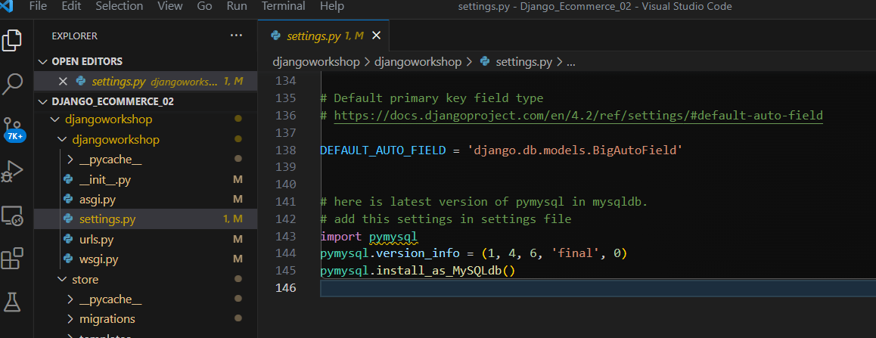
This project run on Dell Computer / Need open Xampp also
The Project run on Dell notebook ( Aug-12-2023)
Database name is Chaison
Found Problem can not see

Slide 2
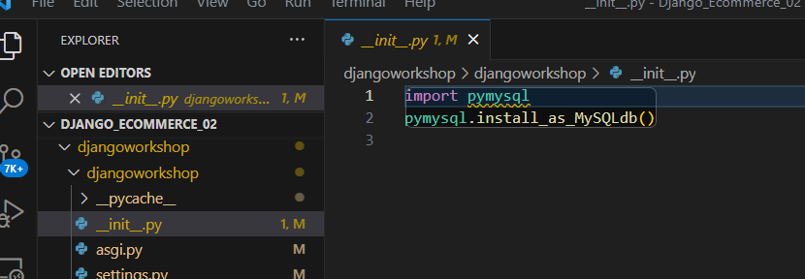
Pip install pymysql

Slide 3
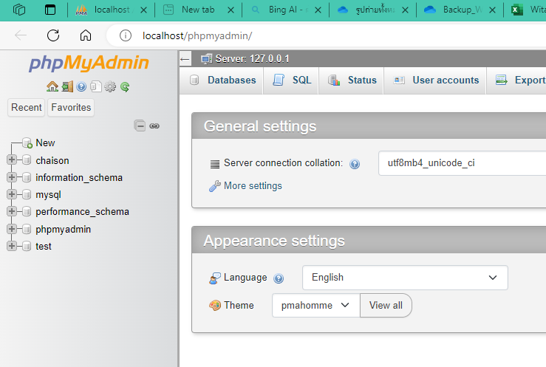
Database is chaison on lenovo

Slide 4
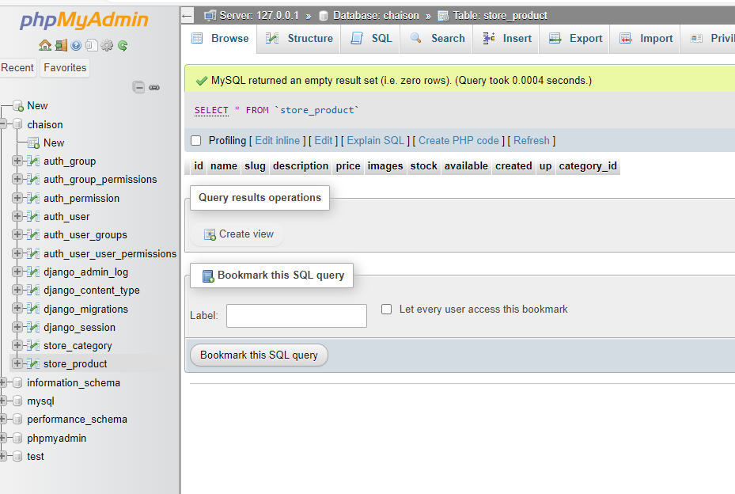

Slide 5
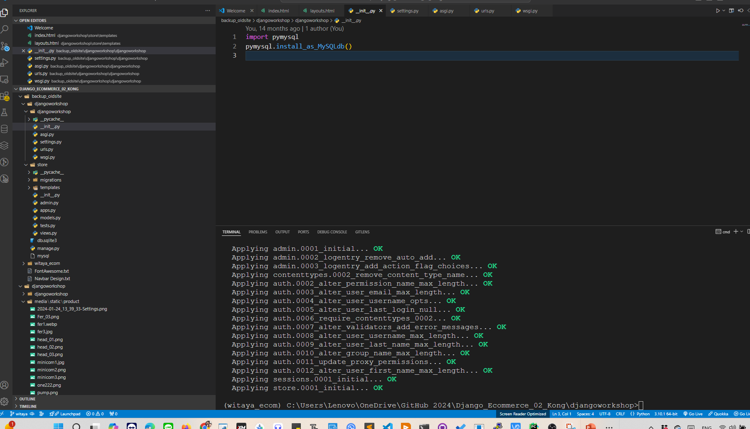
Microsoft Windows [Version 10.0.19045.3208]
(c) Microsoft Corporation. All rights reserved.
อย่าลืม เปิด XAMPP ก่อน activate d-jango นะครับ ➔ Jan_08

Slide 6
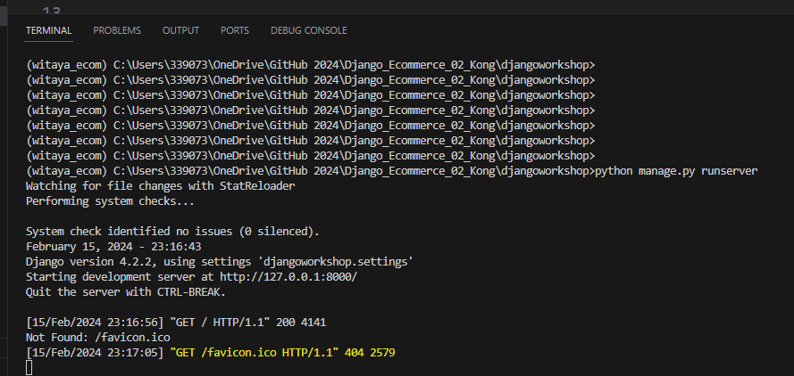
Xampp on Seagate computer is damage

Slide 7
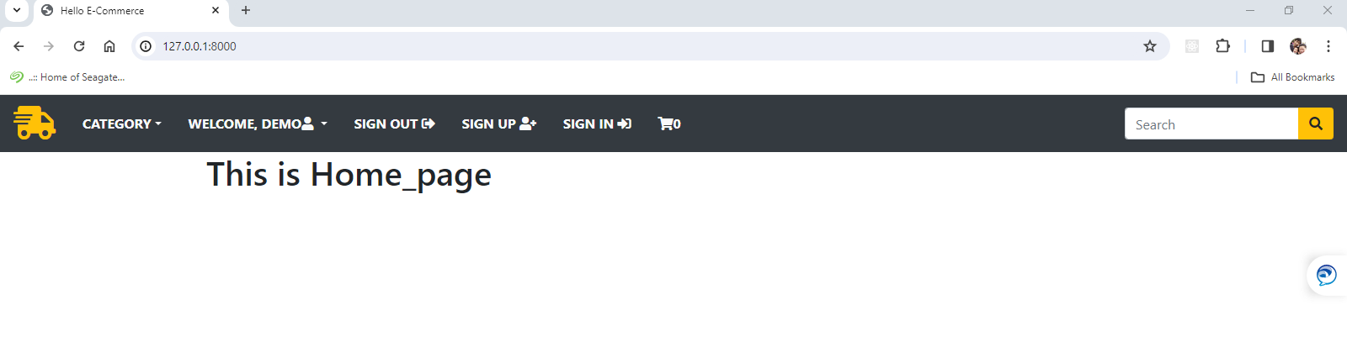
Feb_16_2024
Declare template [os.path,join(BASE_DIR,’templates’] and register app store in paa
Layout.html + CDN popper , Bootstrap + jQuery at script , index.html ( {% extends “layout.html” %}
Install icon with font awesome

Slide 8
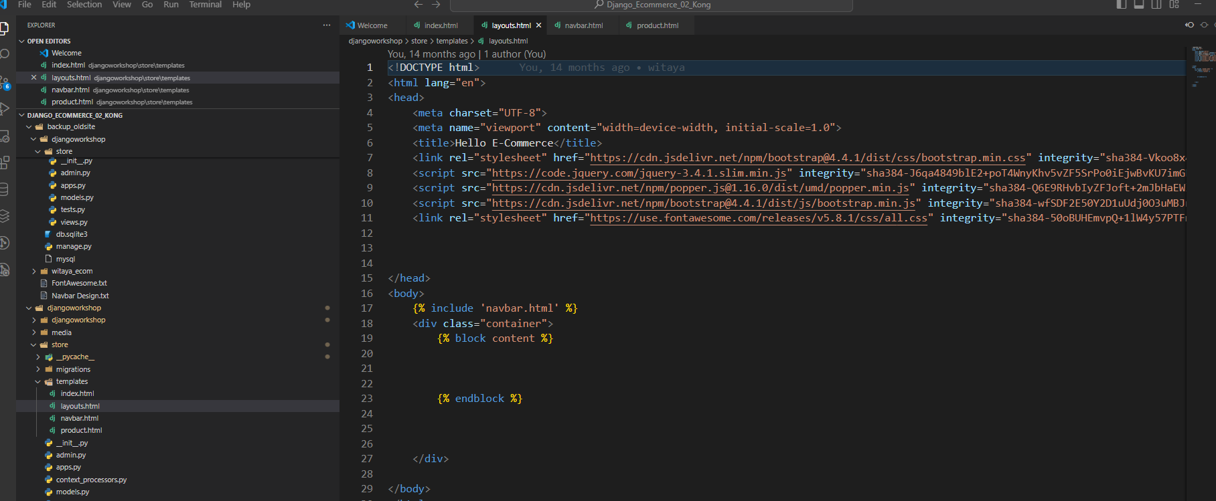

Slide 9
Create model
Create category is object
def__str__(self):
return self.name
1.How to upload picture to django
2.https://www.youtube.com/@LegionScript
3.Deply static on Root directory
4.Deploy Project on Project Folder
5. Lung Engineer upload image ==> https://www.youtube.com/watch?v=rRVWQCpZ_CI&t=15214s
6.How to create image gallory in Django

Slide 10
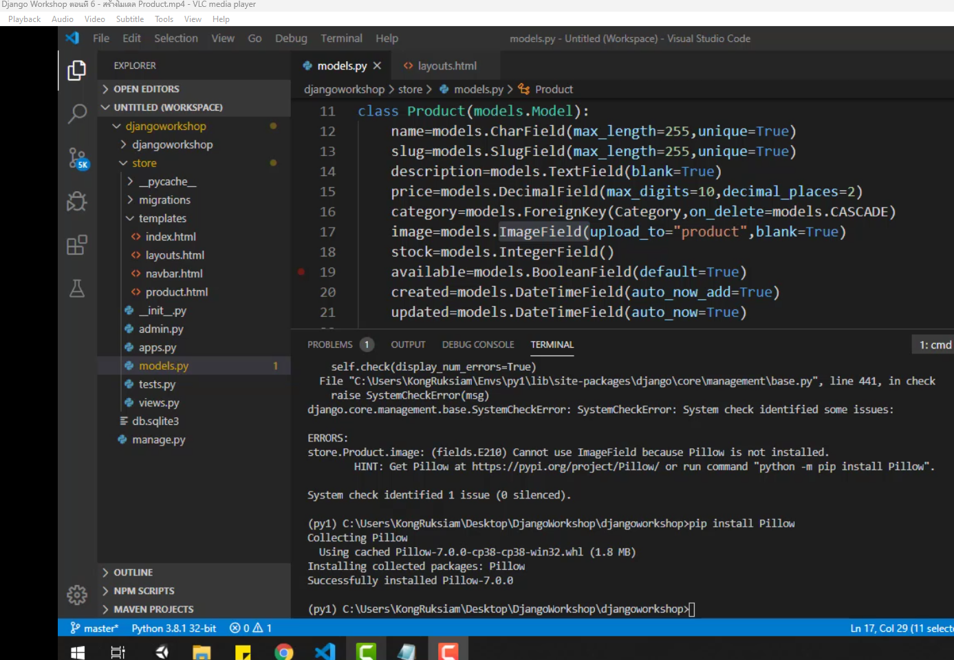

Slide 11
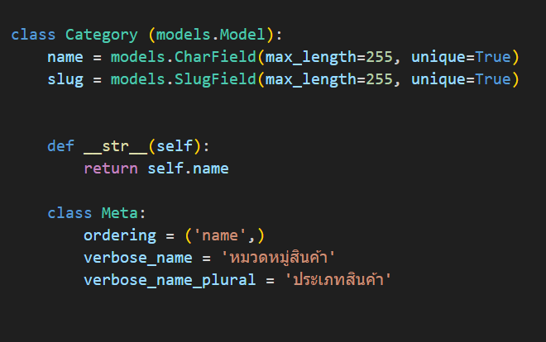
Class Meta:
Ordering = “ name”
verbose_name = “หวดหมู่.
Verbose_name_plural = ประเภทสินค้า
Create category is object
def__str__(self):
return self.name

Slide 12
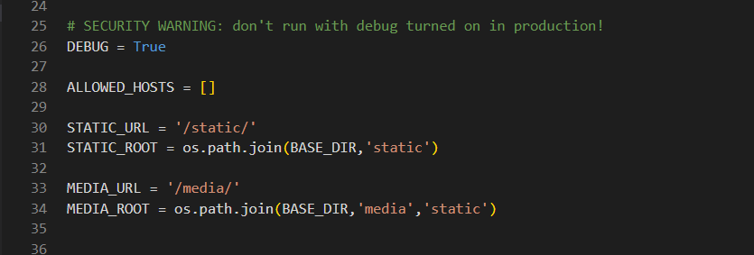
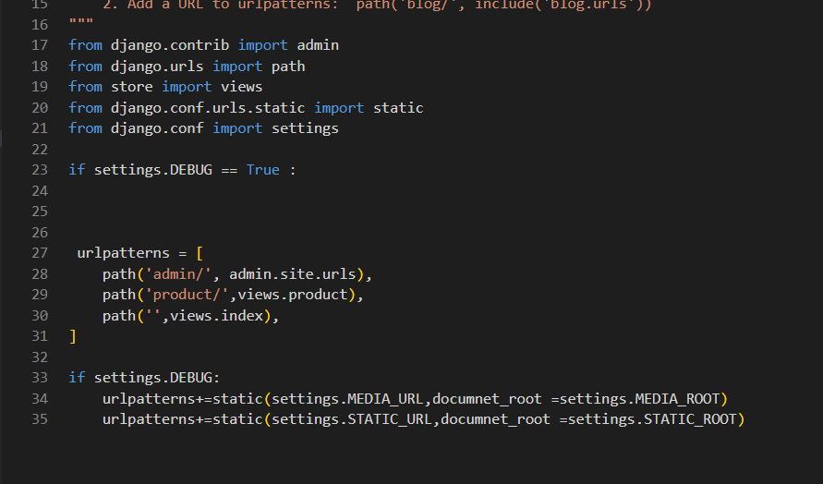
การกำหนดค่า การ upload ภาพ // กำหนดตัวแปล // กำหนด URL // กำหนดการ debug is True when developt //
March_28

Slide 13
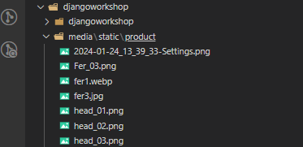
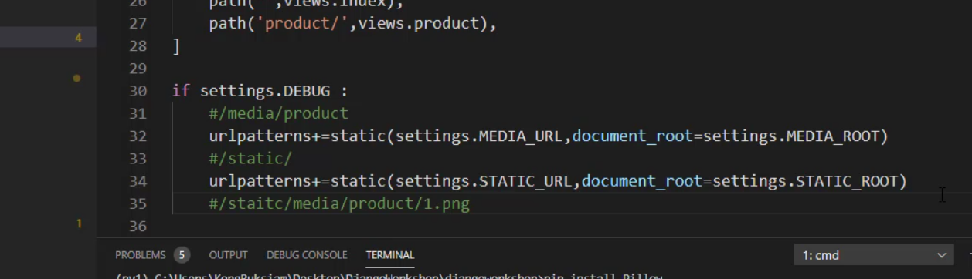

Slide 14
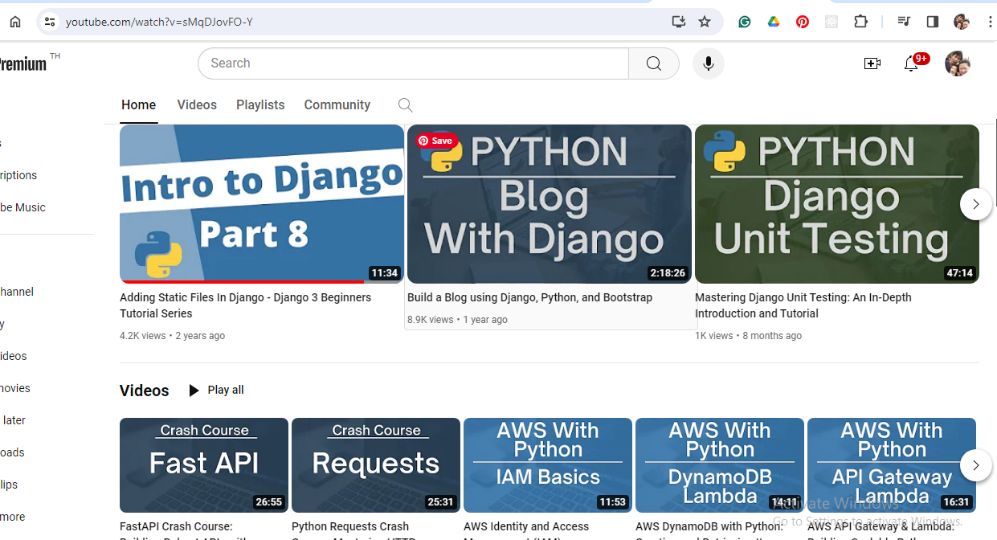
(2837) Legion Script - YouTube
Adding Static Files In Django - Django 3 Beginners Tutorial Series (youtube.com)

Slide 15
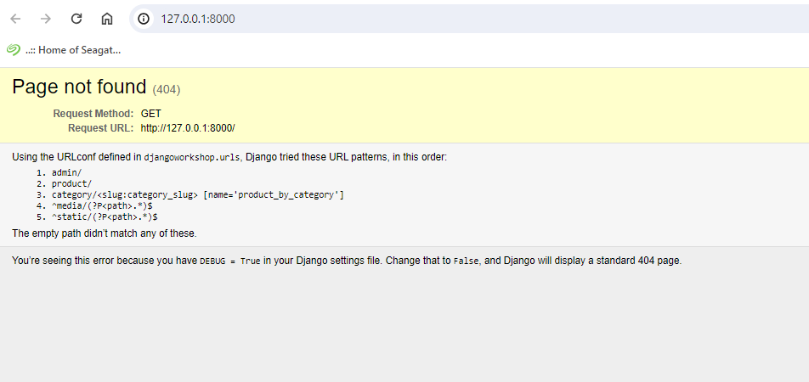
< div class = “ row my-3”

